Slide 1
Newer Java, Newer Eclipse
Speaker : YiFan Chen
Date : 2014 / 03 / 17

Slide 2
Outline
Why would I use Java 7?
About exception handling
Other new features might help you
Why would I use Eclipse 4?
Conclusion
Appendix

Slide 3
What's new in Java7
About exception handling

Slide 4
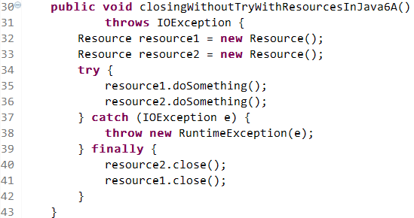
Using two resources
Declared
IOException
Resource leak

Slide 5
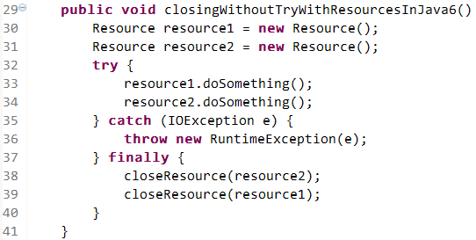
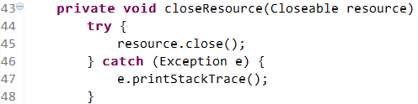
Using two resources
Declare a method to close it

Slide 6
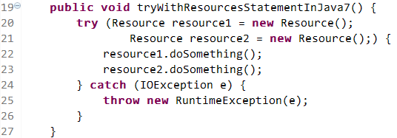
Try-with-resource
AutoCloseable
Channel, Connection, Port, Closeable, …
Finally block
Notes:
Automatically close

Slide 7
How it works
1
2
3
4
7
5
Cloe resource2
6
Cloe resource1
Notes:
2.Sequentially
5.Close the resources by opposite order
7.after that

Slide 8
Try-with-resource
Question:
There are something wrong?
Notes:
What if there are something wrong when closing these resource?

Slide 9
Suppressed Exceptions
Demo
Notes:
TryWithResourceAndSuppressedException
62行，main 6 與 7 更改並執行
拿掉7的getSuppressed註解

Slide 10
Try-with-resource
Question:
There are something wrong?
Answer:
Handle it in catch block
Do nothing
Notes:
What if there are something wrong when closing these resource?

Slide 11
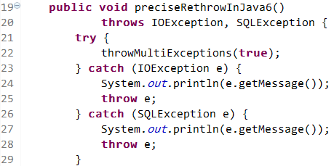

Smarter Rethrow
Duplicate
codes
Declared throws:
IOException, SQLException

Slide 12
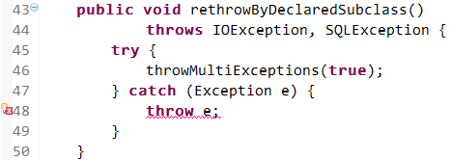
Smarter Rethrow
Error: Unhandled exception type Exception

Slide 13
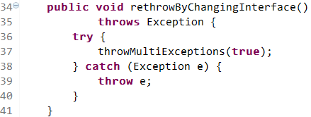
Smarter Rethrow
Too restrictive

Slide 14
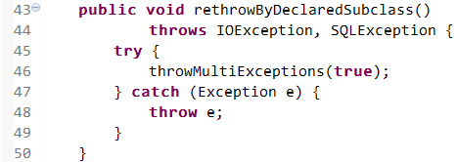
Smarter Rethrow
OK in Java 7

Slide 15
Too Complicated?
There is an other way

Slide 16
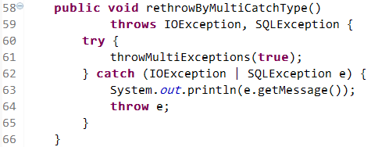

Multi-Catch

Slide 17
What's new in Java7
Other new features might help you

Slide 18
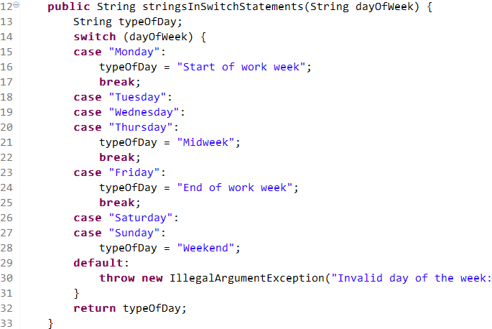
Strings In Switch Statements
Notes:
more efficient than if-then-else statements

Slide 19
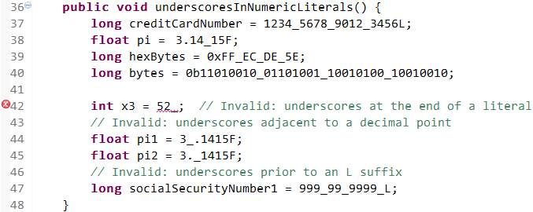
Underscores in Numeric Literals
Notes:
improve the readability

Slide 20
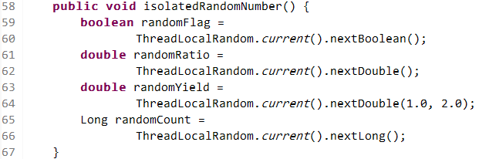
Isolated Random Number
With Interval
With it's own seed
Better than RNG(Random number generation)
Notes:
seed for the thread

Slide 21
What's new in Eclipse 4

Slide 22
Better Memory Managing
About Error
java.lang.OutOfMemoryError: PermGen space
Much less then Eclipse 3.x

Slide 23
Warning by Compiler
Demo
Notes:
Warning 的搜尋功能
TryWithResourceAndSuppressedException 36行 該用TryWithResource
WarningInEclipse4 沒關

Slide 24
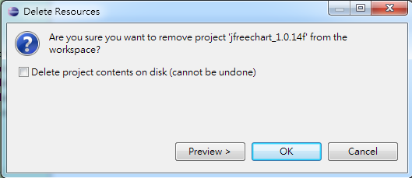
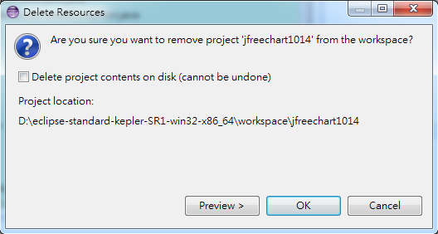
Deleting Project
Eclipse 3.6
Eclipse 4.3
Notes:
The dialog now shows the location of the project to be deleted on the file system.

Slide 25
Newer Ant Version
1.7.1 → 1.8.4

Slide 26
Conclusions

Slide 27
When using Java 7 to develop
Better exception handling
Resource management
Higher readability

Slide 28
When using Eclipse 4
Better user experience
Improve code quality
Notes:
compiler

Slide 29
Thank you !

Slide 30
Appendix

Slide 31
Setting on Eclipse
Java Build Path → Libraries
Java Compiler → JDK Compliance
Run configurations → JRE

